Slide 1

PREDICTING HOSPITAL READMISSION Submitted by: Harshada Karande

Slide 2
PROBLEM STATEMENT
In recent decades, researchers have paid special attention to the readmission rate as it is considered a globally attractive and reliable indicator of the effectiveness and quality of hospital care provided to the patients. National health systems in many countries (e.g., the U.S.) began using the readmission rates as a publicly reported metric that can be used for hospital comparison and determination of hospital services reimbursement. Accurate forecasting of hospital readmissions can contribute significantly to the improvement of the quality of services provided by a specific hospital or by a health care system as a whole. The substantial health, economic and social benefits of such forecasting are undeniable. The benefits for the patients are related to the timely diagnosis and effective treatment of a health issue, the prevention of complications due to the delayed or incorrect treatment, and the shortening of hospitalization time while reducing potential psychological consequences. The number of readmissions to the total hospital admissions is a significant ratio, which can be used as a business intelligence (BI) tool to uncover service quality insights and improve patient care

Slide 3
A. Understanding the dataset, it's dimensions, datatype, variable names.
The dataset contains of 25 thousand rows and 17 columns. There are 10 categorical columns and 7 numerical columns. Few categorical features possess anonymized data, and few features have unbalanced distribution of classes like source.
- Checking for wrongly identified datatypes
All the variables datatypes are correctly identified and assigned
- Multicollinearity
High correlations between two or more independent variables are known as multicollinearity (predictors). This phenomena fundamentally involves the correlation of independent variables. Based on their correlation, it assesses how closely two variables are related.
The target variable appears to be sharing a low to moderate level of correlation with the features of the data.
- The features also share a very low multi - correlation among each other.

Slide 4
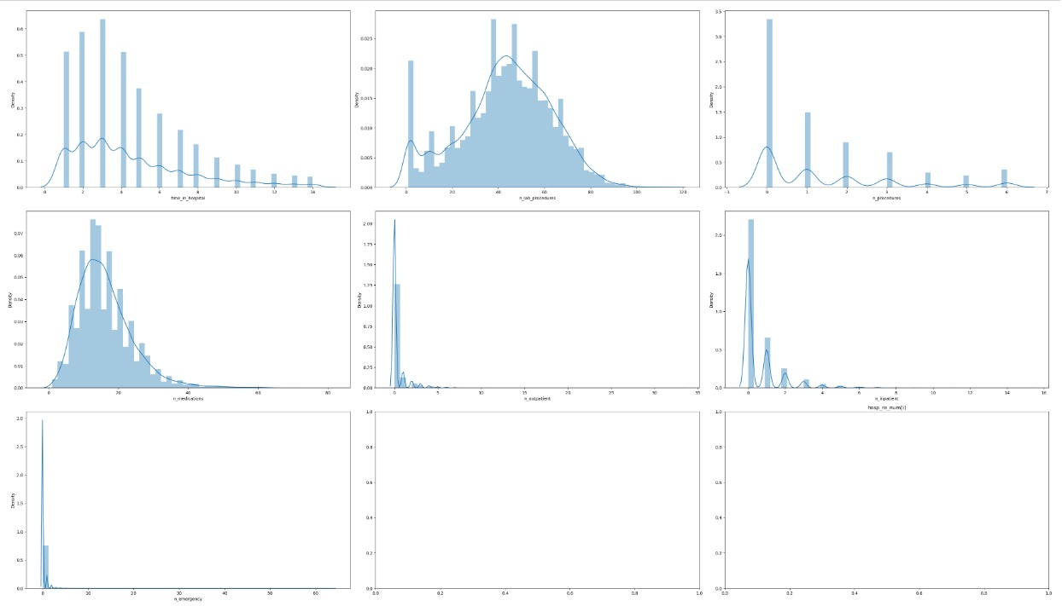
- Checking for distribution,skewness,kurtosis of the data:-
Distribution of the data can be visualised by using the distribution plot method from the seaborn library.

Slide 5
- The skewness of the data gave us the following observations :-
Columns time_in_hospital, n_procedures,n_medications,n_outpatient,n_inpatient, have a high positive right skewness in the distribution of data.
Column n_lab_procedures have a low negatively skewed distribution in data.
Column n_emergency have high positive right skewed distribution in data.
- After checking the kurtosis values it was observed :-
Kurtosis helps us understand how much data values are present in the tails of the data. It helps us identify any extreme fluctuations between values of features. Kurtosis can be of three types let's see which columns the data for the above dataset falls under :
Leptokurtic : Features falling under this category can depict presence of high outliers, as they have skinnier and longer tails displayed in their distribution.
Platykurtic : Features falling under this category show a stability in the movements of the datapoints with shorter tails.

Slide 6
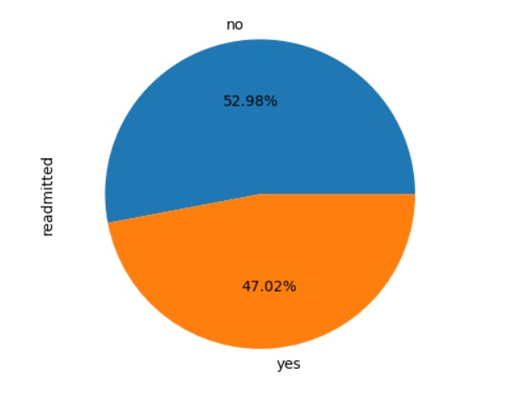
- Finding the distribution of data in the target variable :-
The data has not highly imbalanced weightage for each class.
Unbalanced refers to a classification data set with unbalanced class proportions. Majority classes are those that represent a sizable share of the data set.
Minority classes are those that make up a smaller percentage.
Our target variable ‘readmitted’, is not highly unbalanced feature with classes [yes,no]
and percentage share of 47.02% and 52.98% of yes and no respectively.

Slide 7
B. Data Exploration (EDA)-
Relationship between variables :-
Python provides with vide range of exploratory data analysis libraries via- pandas profiling and sweetviz, which is very useful for univariate and bivariate analysis, feature selections, presence of collinearity, null values, heatmaps and much more.
C. Feature Engineering-
Encoding the data
There were 10 categorical columns that will be required to be encoded in order to move onto model building for the data. Encoding would be performed using the get_dummies function of pandas library.
Identifying the dependent variables and assigning them as X where as assigning the dependent variable (readmitted) as Y for splitting into train and test set.
The split will be done by using the train_test_split functionality from the sklearn.model_selection library package.

Slide 8
D. Model Evaluation (Base Model) :
Models were built on the above data
Decision tree (Base model): Decision tree as taken as my base model.
Random forest (Bagging technique) : Random Forest was selected as it works well with data with high variance.
I choose random forest for its ability to capture non-linear relationships and interactions between features.
Gradient Boost (Boosting technique) : XGBoost was selected as it uses advanced regularization which could improve the model performance and prevent overfitting.
A model can go into overfitting condition for several reasons :
If there is presence of imbalance in the variables data
If there is alot of noise present in the data - The data consists of extreme outliers in multiple columns
If there is any irrelevant features/information present in the data.
Through the heatmap, statistical hypothesis tests conducted earlier and feature importance values derived from the base model it can be determined that there are a few columns that can be considered as irrelevant or of insignificance as they share a very low relation with the target variable.

Slide 9
PERFORMANCE METRICS OF THE MODEL:
Accuracy: Overall correctness of the model’s predictions.
Precision: Proportion of true positive predictions to the total predicted positives.
Recall (Sensitivity): Proportion of true positives to the total actual positives.
F1 Score: Harmonic mean of precision and recall, providing a balance between the two.
ROC-AUC: Measure of the model’s ability to distinguish between classes.

Slide 10

- THEORETICAL EXPLAINATION OF FINAL MODEL.
Random Forest is an ensemble learning method that combines multiple decision trees to improve prediction accuracy and control overfitting. It is commonly used for classification and regression tasks.
During the construction of each tree, Random Forest randomly selects a subset of features for splitting at each node. This further decorrelates the trees, ensuring that they do not all make the same mistakes.
Tree Construction:
For each tree t in the ensemble:
Randomly sample n observations from the training dataset with replacement (bootstrapping).
Randomly select mmm features from the total p features (where m<p ) at each node.
Split the data at each node using a criterion (e.g., Gini impurity for classification or Mean Squared Error for regression) to minimize the impurity or error.
Impurity Measures:
Gini Impurity (for classification):
where pi is the proportion of class i in dataset .

Slide 11
- SUGGESTED IMPROVEMENTS
Hyperparameter Tuning:
Optimizing parameters like the number of trees (n_estimators), maximum depth of each tree (max_depth), and minimum samples required to split a node (min_samples_split) can significantly improve model performance. This tuning helps balance bias and variance, allowing the model to generalize better to unseen data.
Feature Selection:
Using feature importance scores generated by Random Forest can help identify and retain only the most impactful features. Removing irrelevant or redundant features can reduce noise and improve model accuracy, leading to better predictions of patient readmission.
Increasing Number of Trees:
Adding more trees can reduce overfitting and improve robustness, especially if computational resources allow it. A larger ensemble can capture more complex patterns in the data and improve overall prediction accuracy.
Outlier Detection and Handling:
Identifying and appropriately handling outliers can improve model performance. Outliers can skew predictions and lead to misleading results.
Cross-Validation:
Implementing k-fold cross-validation during model training helps ensure that the model is evaluated on different subsets of data, leading to a more reliable estimate of its performance. This practice helps in selecting the best model parameters.

Slide 12
Model evaluation
The Random Forest Algorithm uses feature similarity to identify and determine the prediction of the datapoints.
The algorithm identifes and understands the patterns in the training set of the data based on which the test datapoints get predicted for the classes.
Model Evaluation :
The model was evaluated by creating classification report deriving the precision, recall, f1-score, accuracy of the training and test data.
- Looking at the accuracy score it can be said that the model is a goodfit with not much difference for train and test data accuracy at 0.80 and 0.62 respectively.
1. Precision : determines the number of correct outputs are provided by the model. Out of all the predicted values it gives us the ratio for how many of them were actually true.
- In this case the precision of the model is shows higher precision for class 1 than class 0.
2. Recall : gives us the ratio that out of all the positive classes how many of them were correctly predicted by our model.
- For our above model, the recall is higher for class 0 in train and test set, for class 1 it is higher for train set but comparatively lower for training set. This indicates that the actual positive values for class 0 is being more accurately predicted by the model.
3. F-1 score : f1 score gives us the score by evaluating the precision and recall measures at the same time.
- The f1 score here is pretty high for train and test set as for both the classes.

Slide 13
2. Business interpretation :
Looking at the precision values, it was observed that the possibility of the value predicted as 0 is lesser than that of the class 1 . We can say that the model is predicting patient is readmitted to hospital activities well.
Since the recall values show a better result for class 0 and precision values show a better result for class 1 we'll consider the f1 score as a measure for evaluating the accuracy. Here the f1 score as well shows a good measure for training and test set of class 0 and training set of class 1.
This can be interpreted as –
1. The model is giving a good performance for the prediction of patient is readmitted to hospital or not.
2. Although the evaluations showcase that there is a lower recall value for readmitted being actually true, it is still high considering that the happenings of not admitted are also lower, and the data itself had a lesser number of active readmitted datapoints present.
3. Overall it can be said that the model is good fit model.

